Slide 1


Phishing Awareness: Don't Take the Bait
Abhinav S Kumar

Slide 2

CONTENTS
1. Introduction
2. What is Phishing?
3. How Phishing Works
4. Recognizing Phishing Emails
5. Spotting Fake Websites
6. Social Engineering Tactics
7. Real-World Examples
8. Best Practices to Stay Safe
9. Quiz (Interactive)
10. What to Do if You Suspect Phishing
11. Wrap Up & Key Takeaways
12. Thank You

Slide 3

01
Introduction

Slide 4
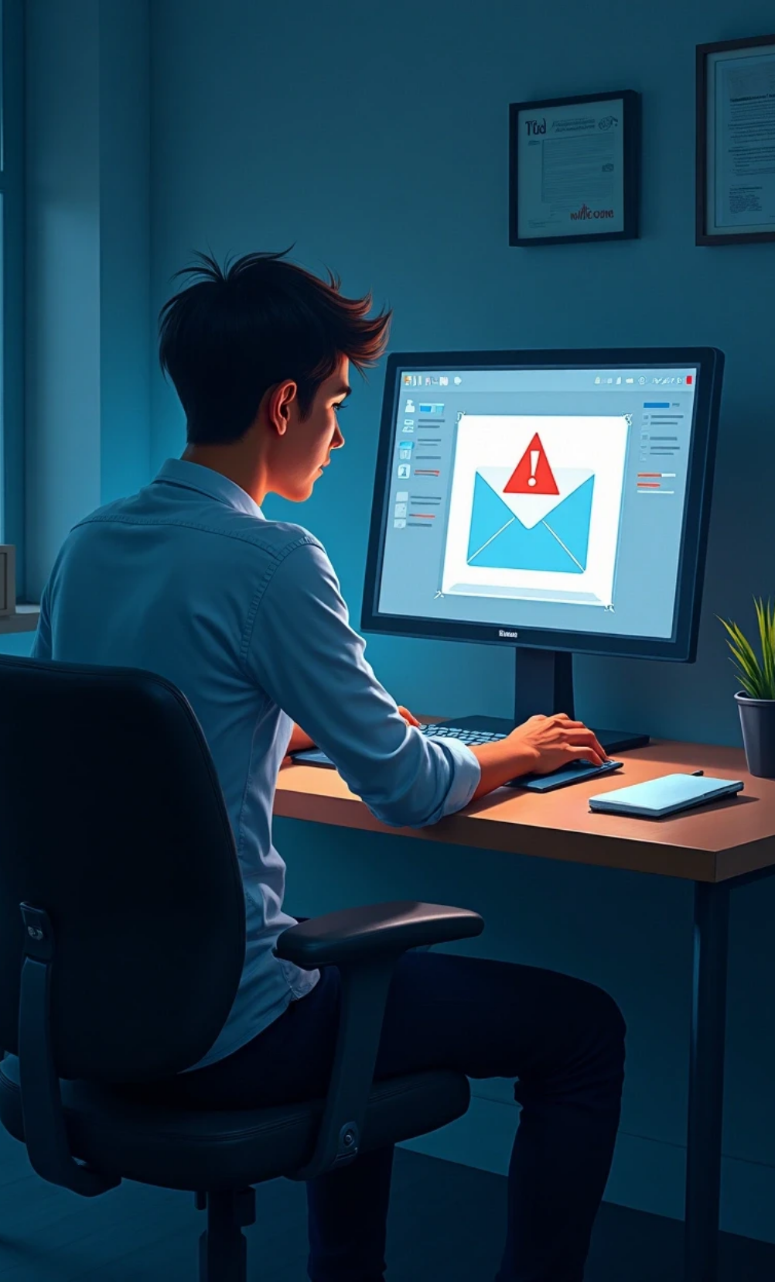
Introduction
Cyber attacks are rising → 90% of data breaches start with phishing.
Anyone can be a target: employees, students, individuals.
Objective: Learn how to spot phishing and protect yourself.

Slide 5

02
What is Phishing?

Slide 6


What is Phishing?
1
Definition
Phishing is a cybercrime where attackers trick people into revealing sensitive information (passwords, credit cards, bank details).
2
Delivery Methods
Delivered via email, SMS (smishing), calls (vishing), fake websites, or social media messages.
3
Example
“Your account has been suspended. Click here to verify.”

Slide 7

03
How Phishing Works

Slide 8
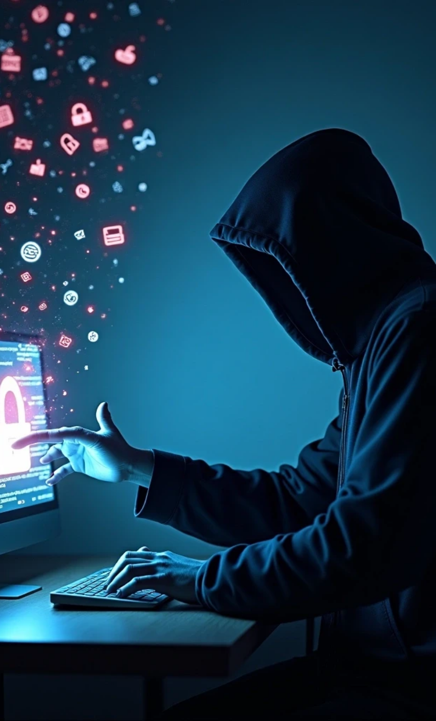
How Phishing Works
Attacker sends a fake message pretending to be trusted.
User is lured to click a link/attachment.
Victim enters details or downloads malware.
Data is stolen → financial loss, identity theft, or company breach.

Slide 9

04
Recognizing Phishing Emails

Slide 10



Recognizing Phishing Emails
🔎 Red Flags:
Generic greeting (“Dear Customer”).
Spelling/grammar mistakes.
Suspicious sender address.
Urgency / fear tactics (“Act now or account closed!”).
Links don’t match official domain.
Unexpected attachments.

Slide 11

05
Spotting Fake Websites

Slide 12

Spotting Fake Websites
1
Look for HTTPS
2
Check domain name
but beware – attackers use HTTPS too.
carefully (e.g., paypaI.com vs. paypal.com).
3
Beware of popups
4
Use official apps
asking for login credentials.
or bookmarks, not email links.

Slide 13

06
Social Engineering Tactics

Slide 14



Social Engineering Tactics
🎭 Attackers manipulate human behavior:
Urgency
Authority
Curiosity
“Limited time to secure your account.”
Posing as boss, bank, or IT admin.
“See who viewed your profile.”
Fear
Greed
“Your account will be locked.”
Fake rewards or gift cards.

Slide 15

07
Real-World Examples

Slide 16
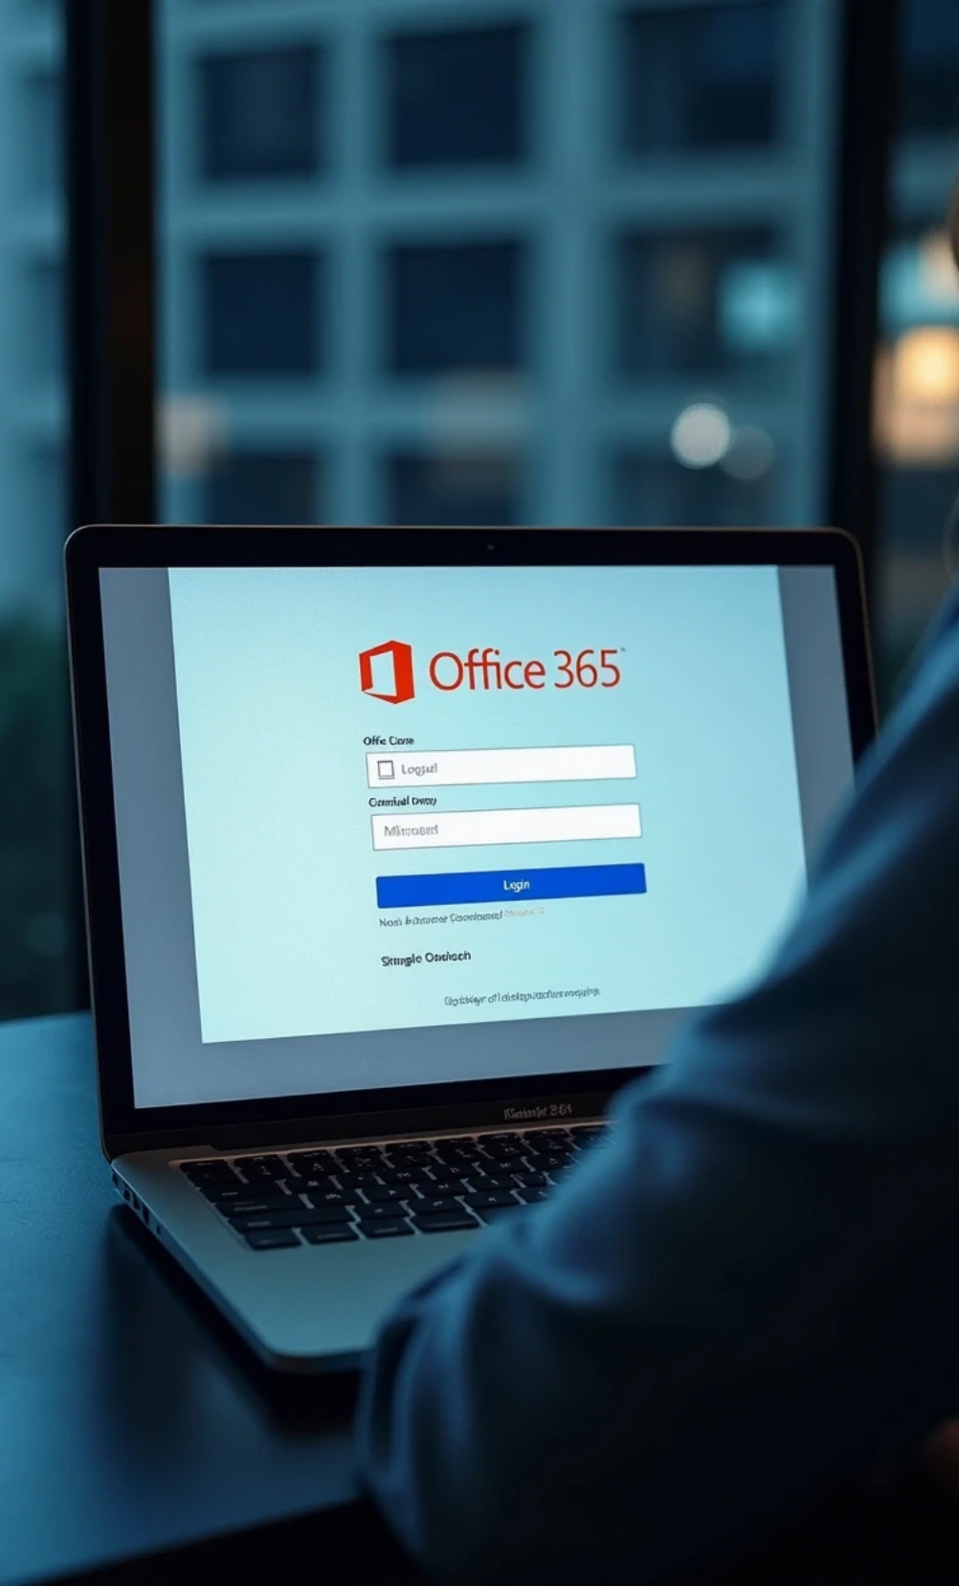
Real-World Examples
Example 1: Fake Microsoft Office 365 login page.
Example 2: Spear-phishing → CEO fraud asking for urgent money transfer.
Example 3: SMS scam → “Track your package here.”

Slide 17
08
Best Practices to Stay Safe

Slide 18
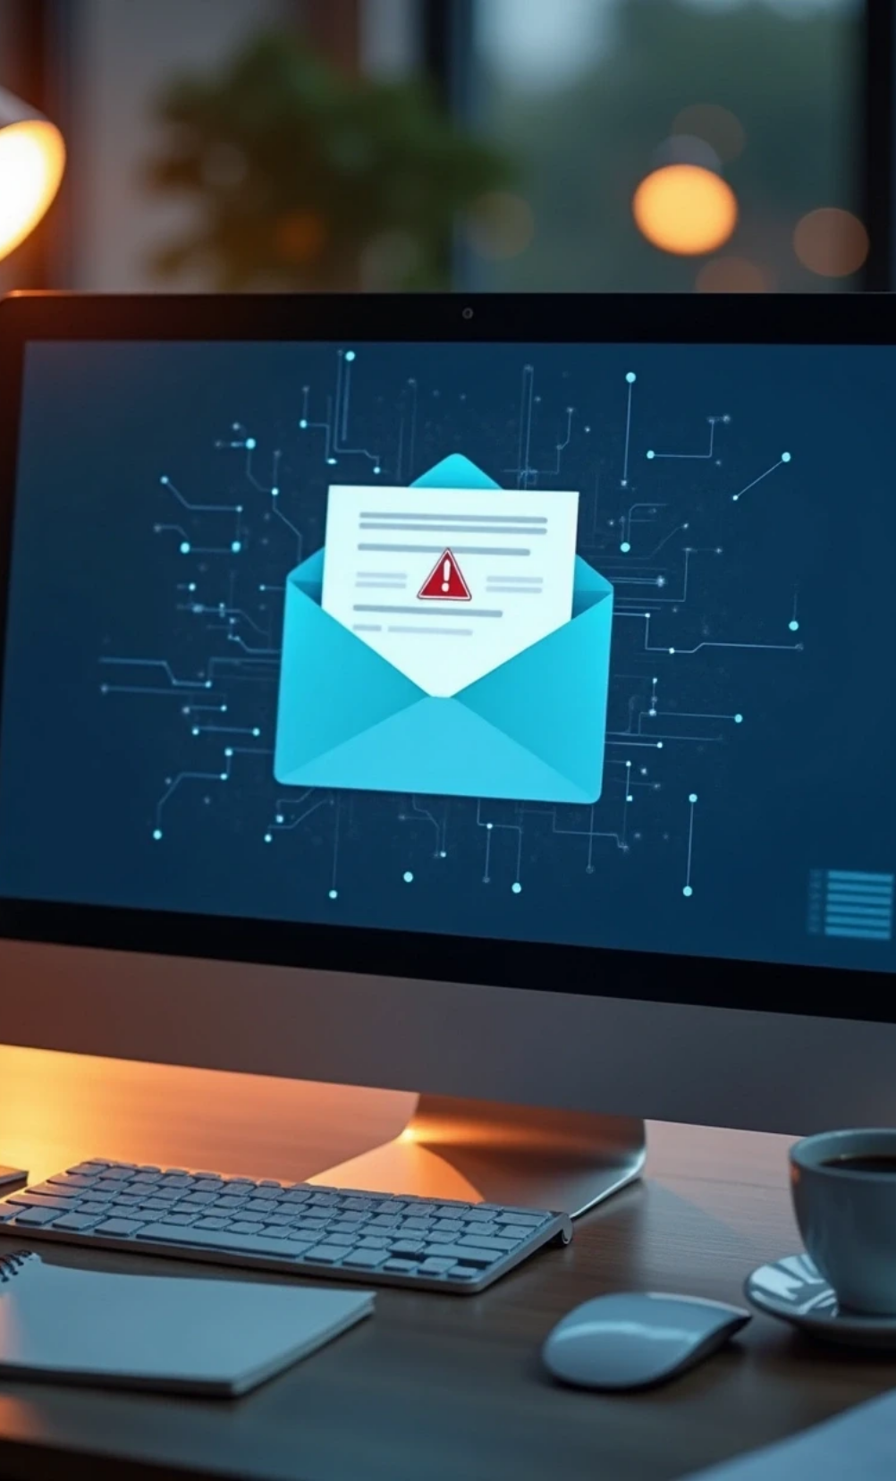
Best Practices to Stay Safe
✅ Think before you click.
✅ Hover over links before opening.
✅ Verify sender identity.
✅ Use multi-factor authentication (MFA).
✅ Report suspicious emails to IT/security team.
✅ Keep software and antivirus updated.

Slide 19

09
Quiz (Interactive)

Slide 20
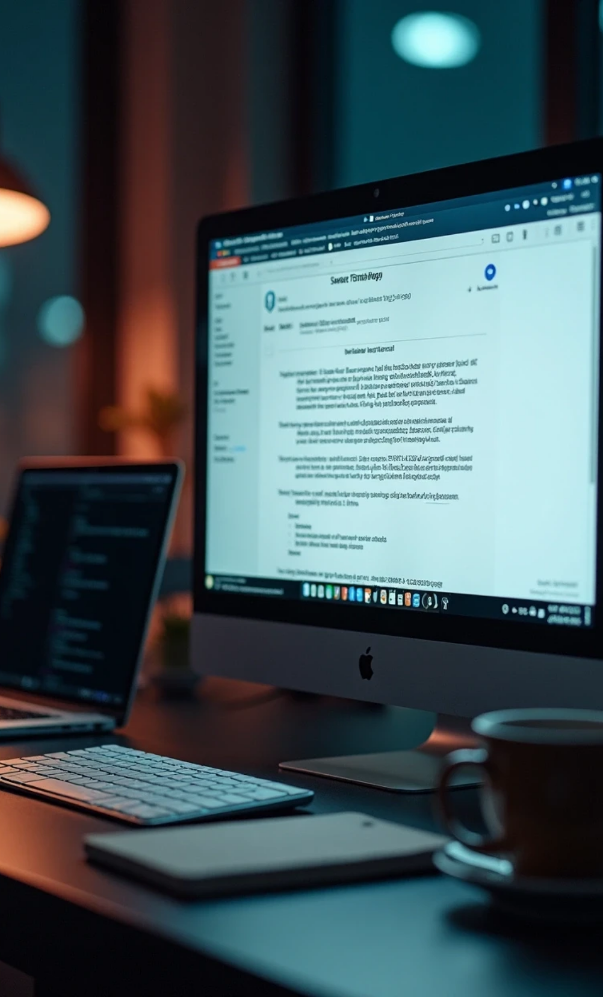
Quiz (Interactive)
Question 1:
Which of these is a sign of phishing?
A) Email from your bank with your full name and no errors
B) Email with urgent tone, asking to click a link immediately
C) Email from HR with expected monthly newsletter
(Correct: B)
Question 2:
The URL “https://faceboook.com” is:
A) Legitimate
B) Fake
(Correct: B)

Slide 21

10
What to Do if You Suspect Phishing

Slide 22
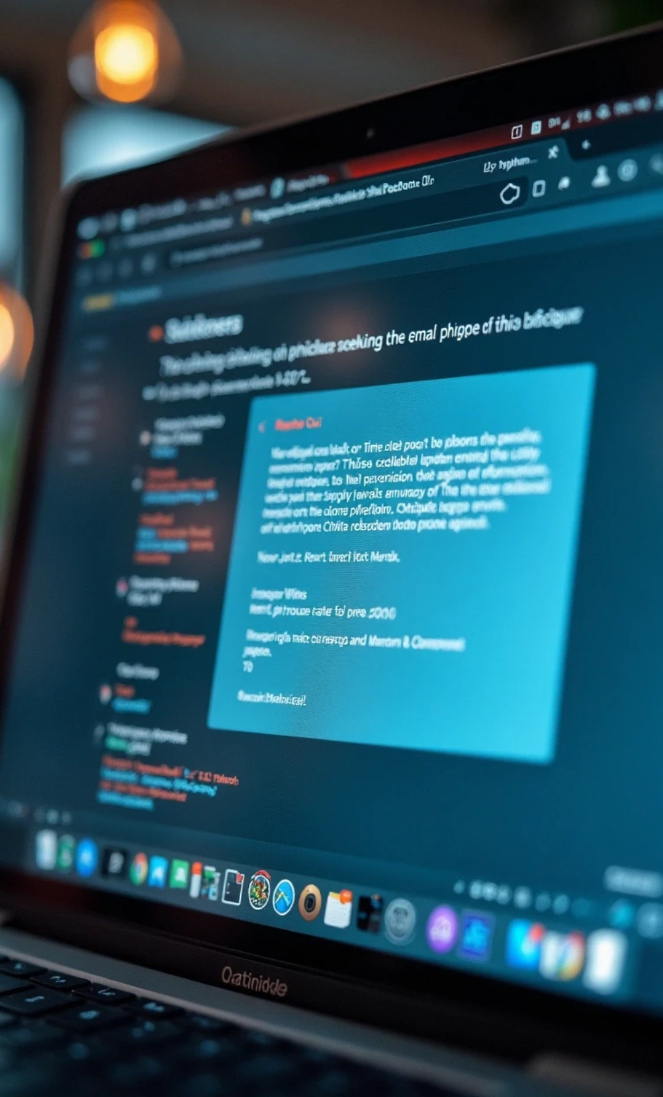
What to Do if You Suspect Phishing
Do NOT click or download.
Report it immediately.
Delete the email/message.
If clicked → change passwords, enable MFA, notify IT.

Slide 23

11
Wrap Up & Key Takeaways

Slide 24
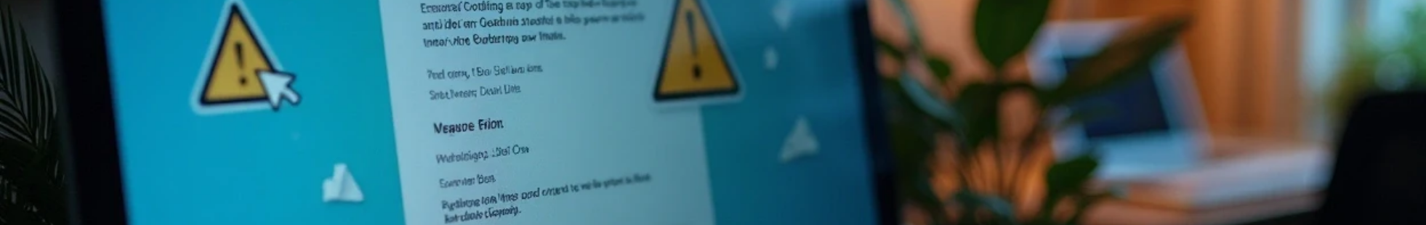
Wrap Up & Key Takeaways
Stay alert – phishing is about tricking YOU, not hacking your computer.
Always verify before clicking.
Reporting = protecting yourself and the organization.

Slide 25
Thank You

